Slide 1






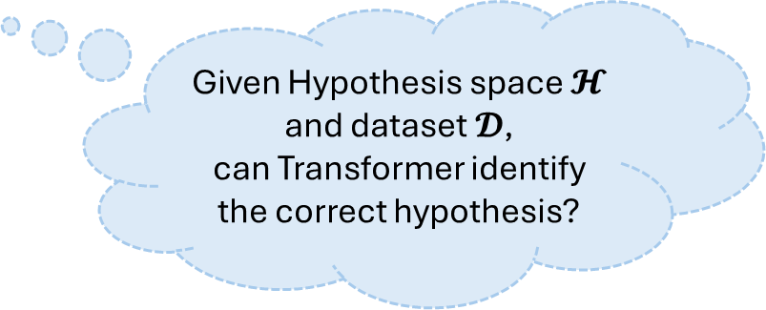



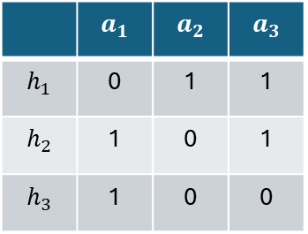


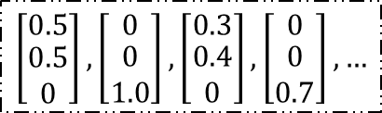
Type 1: Unaligned Sequence
Type 2: Aligned Sequence
0
1
2
$$y_{k}=f(x_{k})$$
1,0,2,2,1,2,…
$$x_{k}$$
$$x_{k}$$
Common-used
or
Transformer
$$\left[\begin{matrix}0.5 \\ \begin{aligned}0.5 \\ 0\end{aligned}\end{matrix}\right],\left[\begin{matrix}0 \\ \begin{aligned}0 \\ 1.0\end{aligned}\end{matrix}\right],\left[\begin{matrix}0.3 \\ \begin{aligned}0.4 \\ 0\end{aligned}\end{matrix}\right],\left[\begin{matrix}0 \\ \begin{aligned}0 \\ 0.7\end{aligned}\end{matrix}\right],…$$
Transformer
$$\left[\begin{matrix}0.5 \\ −0.5\end{matrix}\right],\left[\begin{matrix}0.5 \\ 0.5\end{matrix}\right],\left[\begin{matrix}0.5 \\ −0.5\end{matrix}\right],…$$
$$x_{k+1}=f(x_{k})$$
$$x_{1},x_{2},x_{3},…,x_{k−1}$$
$$x_{1},y_{1},x_{2},y_{2},…,x_{k}$$
$$𝓗=\{h_{1},h_{2},h_{3}\}$$
$$h_{?}$$
Given Hypothesis space $𝓗$
and dataset $𝓓$,
can Transformer identify the correct hypothesis?
 | $$a_{1}$$ | $$a_{2}$$ | $$a_{3}$$
$$h_{1}$$ | 0 | 1 | 1
$$h_{2}$$ | 1 | 0 | 1
$$h_{3}$$ | 1 | 0 | 0
Transformer
This work
hypothesis prefix
$$x_{1},y_{1},x_{2},y_{2},…,x_{k},y_{k},>$$
$$𝓓={\left\{(x_{k},y_{k})\right\}}_{k=1}^{K}$$

